Slide 1
FLUID DYNAMICS
Ms.Arockia Jayaseely,M.sc.,M.Phil.,
Assistant professor
Dept. of Maths, shift-II

Slide 2
Fluids and solids
Fluids is any substance that flows.
Solid is any substance that does not flows.
Fluid Dynamics
Science treating the study of fluid in motion.
it is a branch of mechanics.

Slide 3
fluids
Fluids, they are two kinds
************************************
Liquids --------> Incompressible
Gas --------> Compressible

Slide 4
Kinematics of fluids in motion
Real fluids and Ideal fluids
Orthogonal curvilinear system
Let P(x,y,z) be any point in space with respect to a triangular co-ordinate system , suppose there exists uniform curves
λ (x,y,z)=k
μ( x,y,z)=m ---------1
ϒ(x,y,z)=n

Slide 5
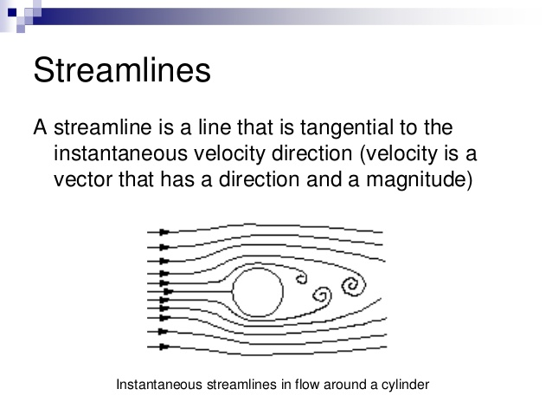
Streamlines
1

Slide 6
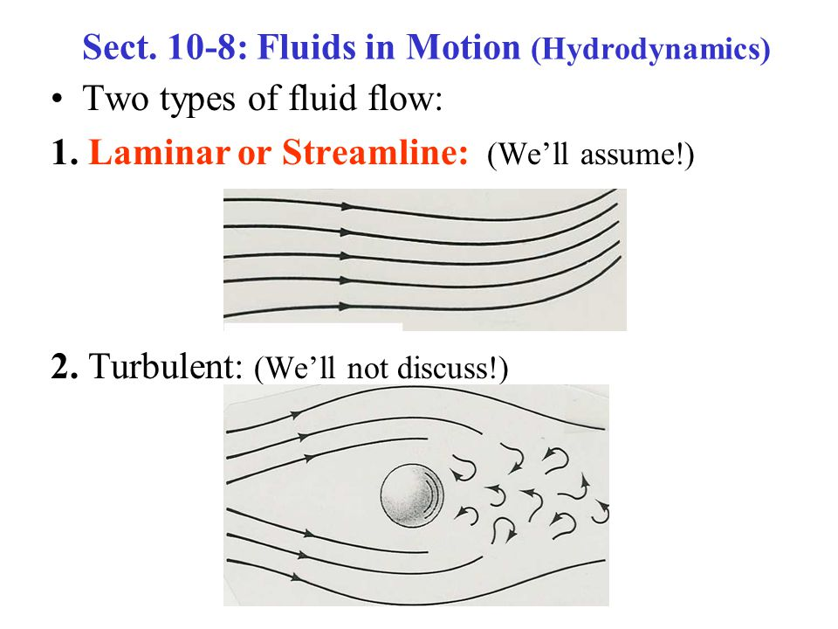
2

Slide 7
It is based on the following assumptions:
The fluid is non-viscous (i,e., the frictional losses are zero).
The fluid is homogeneous and incompressible (i.e., mass density of the fluid is constant).
The flow is continuous, steady and along the streamline.
The velocity of the flow is uniform over the section

Slide 8
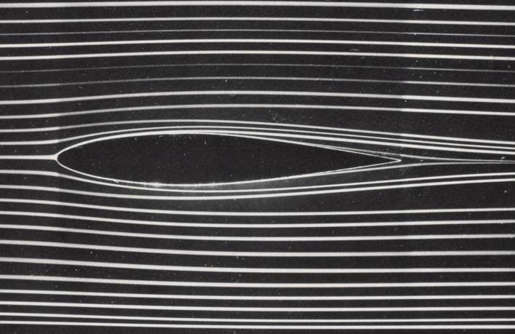
Stream line

Slide 9
Pathline & Streamline
Pathline
Streamline
Flux through a surface:
Only the normal component of the local relative velocity of fluid with respect to the surface ( ) can transport fluid across the surface.

Slide 10
Coincidence of Pathlines, Streamlines, Streaklines
Unsteady flows:
Pathlines, streamlines, and streaklines are not the same.
Steady flows:
Pathlines, streamlines, and streaklines are identical.

Slide 11
THANK YOU

